Slide 1
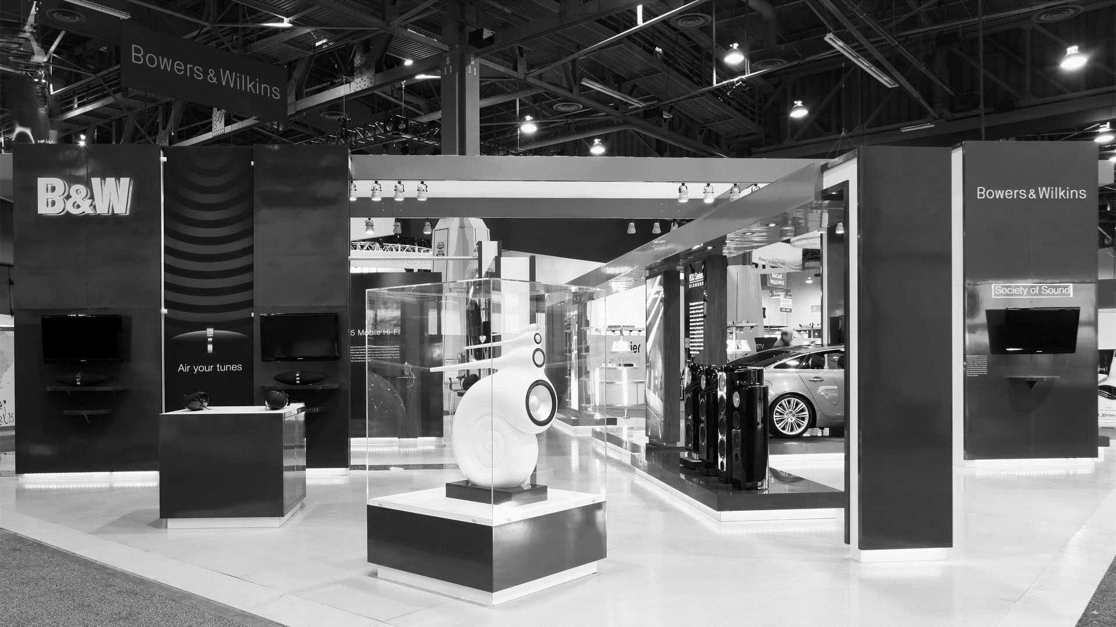
Online Multi Shop
Project in C

Slide 2

Team Member - 03
Name: MD. Mehedi Hasan
ID: 19202103264
Intake: 44
Sec: 07
E-mail: 19202103264@cse.bubt.edu.bd
Team Member - 02
Name: MD. Zobayer Hasan Nayem
ID: 19202103274
Intake: 44
Sec: 07
E-mail: 19202103274@cse.bubt.edu.bd
Team Member - 01
Name: Tunazzinur Rahman Kabbo
ID: 19202103268
Intake: 44
Sec: 07
E-mail: 19202103268@cse.bubt.edu.bd
Presented
By

Slide 3

Introduction
Problem Definition
Proposed Model
System Requirements
Result
Conclusion
Future Work
Reference
Project
Review

Slide 4
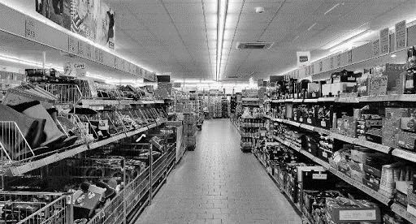
1. An online shop is a medium where everyone buys and sells products laying on there couch.
2. This is a virtual representation of a physical shop.
3. In online shop system people can buy their desired products.
4. Even shopkeepers has chosen this medium to show their product to everyone.
5. With this service, every person can buy his necessities.
6. So that he can get the product very easily.
7. So we have created an online multi shop with C program.
This system has been created to reduce problems that can happen in a physical shop.
Introduction

Slide 5

Problem Definition
1. Nowadays it is very unbearable to go to the shops and markets.
2. A crowd of people inside these made the environment destructive .
3. It is a very time killing process too to buy a product from that crowd.
4. On the other hand people can’t get a good deal on their desired product.
5. So, online shops are created to reduce this difficulties.
6. People can now buy a product within some finger taps.
7. Online shops are also giving the best deals available on the market.
8. On the other hand during pandemic, we can’t go out to buy products Freely
So, online shops play a vital role solving that problem.

Slide 6
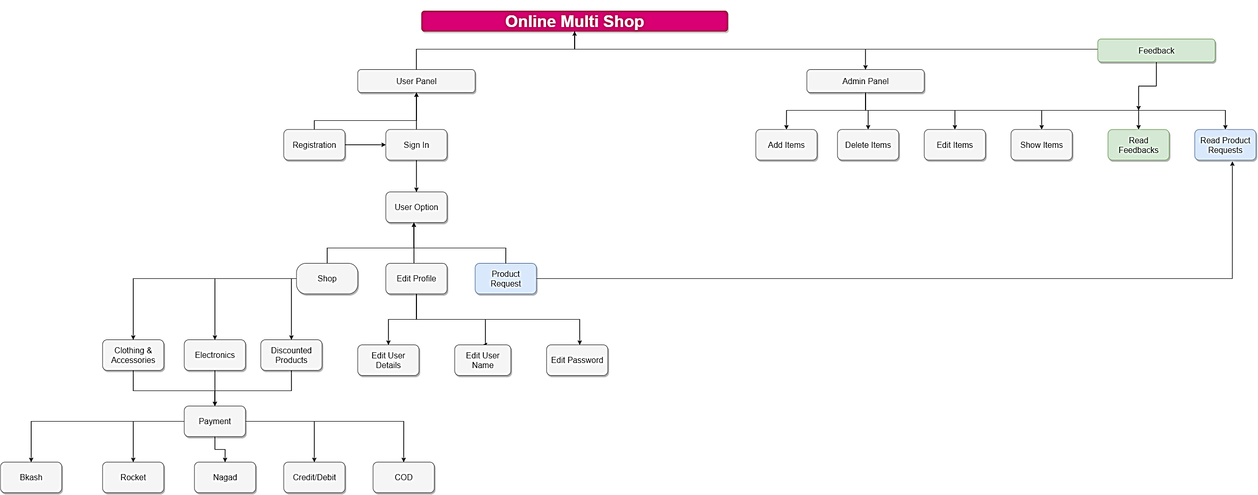
Proposed Model

Slide 7
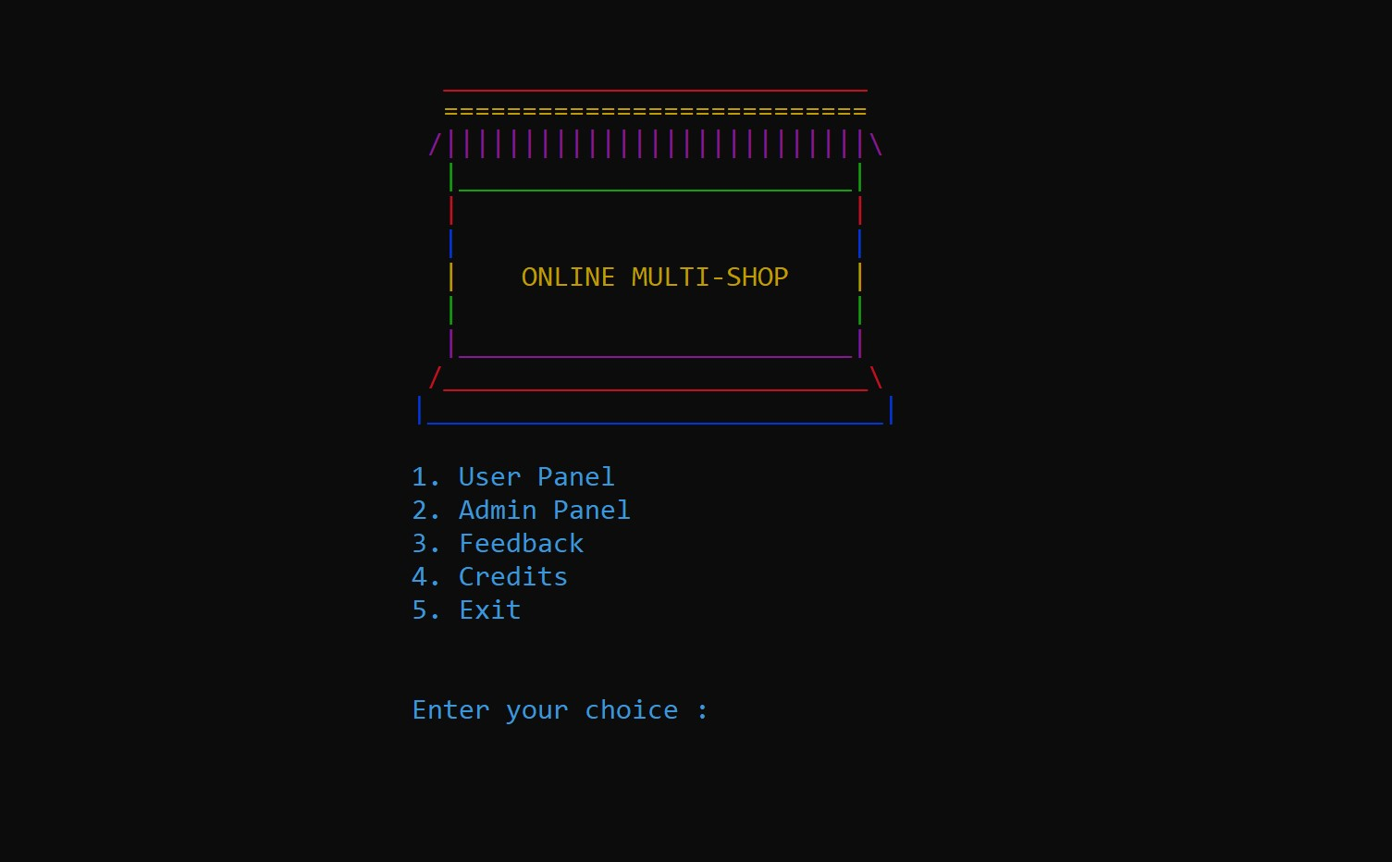
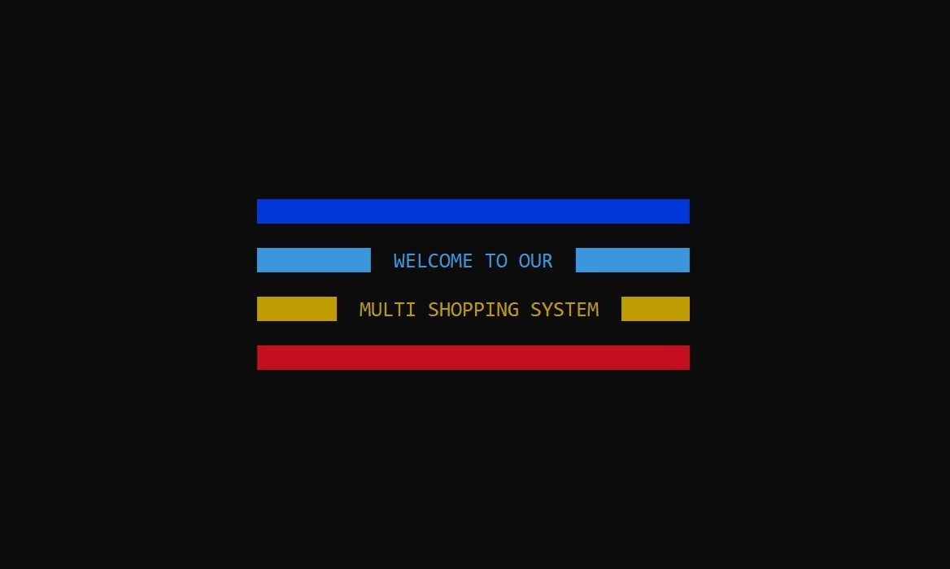

Slide 8


HARDWARE REQUIREMENTS (minimum requirement):
Minimum RAM: - 1GB or more
Hard Disk: - 40 GB or more
Processor: - Intel Pentium 3 or above
SOFTWARE REQUIREMENTS (minimum requirement):
Operating system: Windows 2000/2008 / 2010 /
NT/ XP/ Vista
Analyzing Software: Dev C++, Code blocks etc.
Compiler : Standard C++ Compiler
Data Composer : Microsoft office program
System Requirements

Slide 9
RESULT

Slide 10
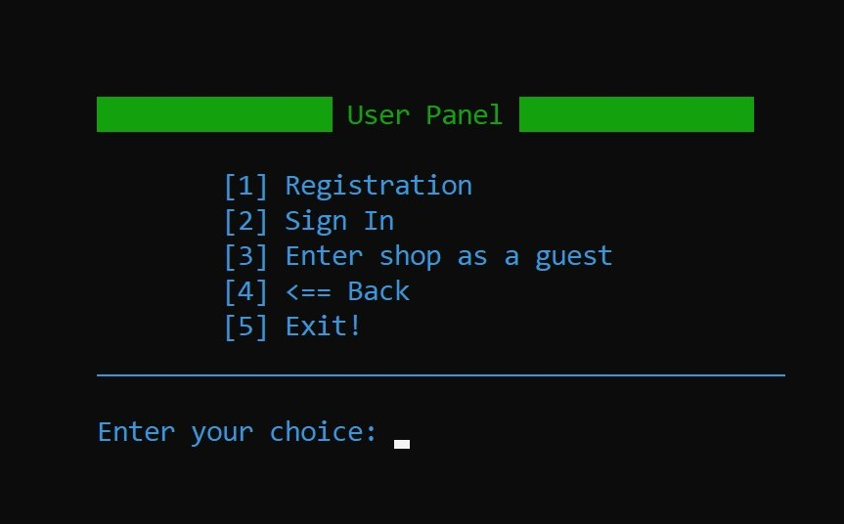
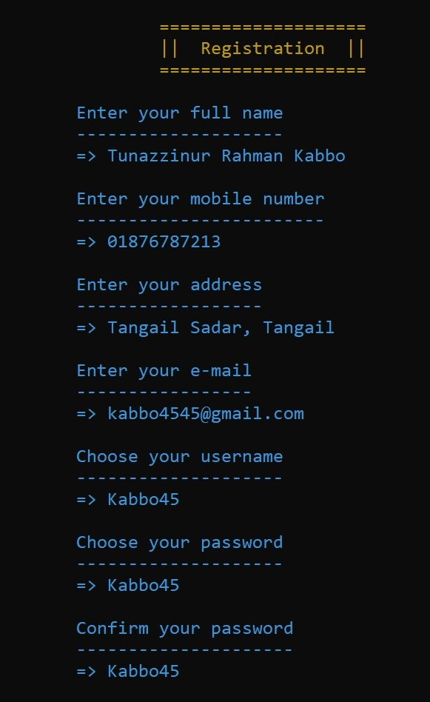
Enter Your
Full Name
Mobile Number
Address
E-mail
Username
Password
How to register

Slide 11
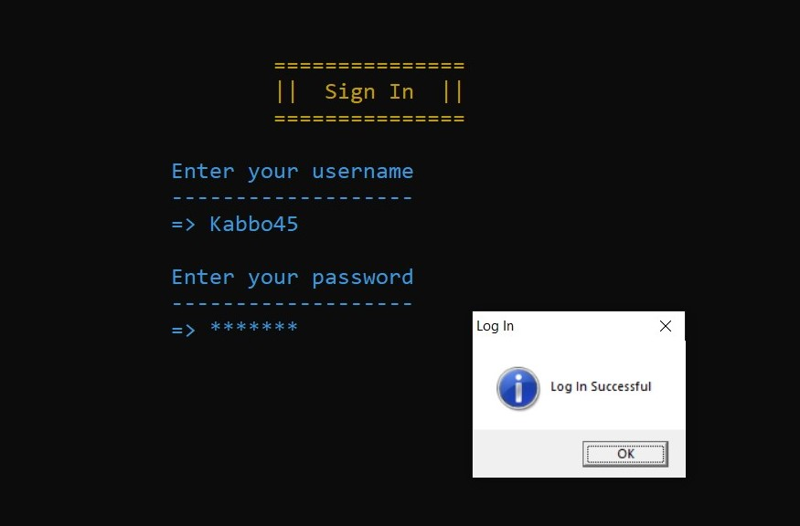
Enter Your
User Name
Password
How to sign in

Slide 12
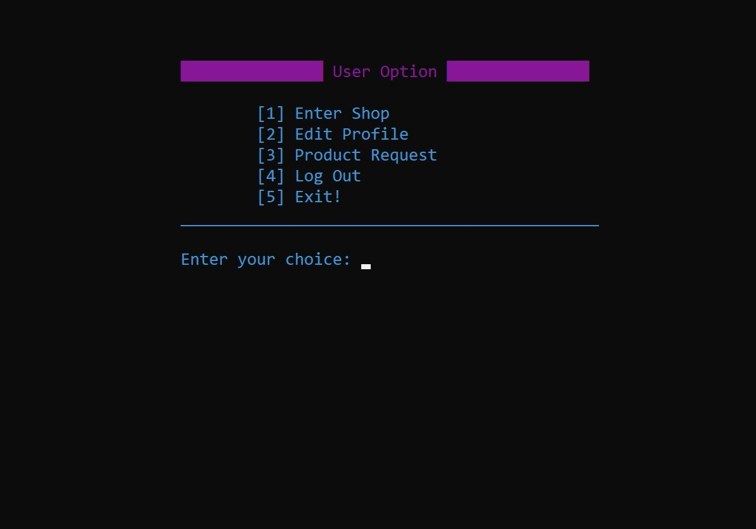
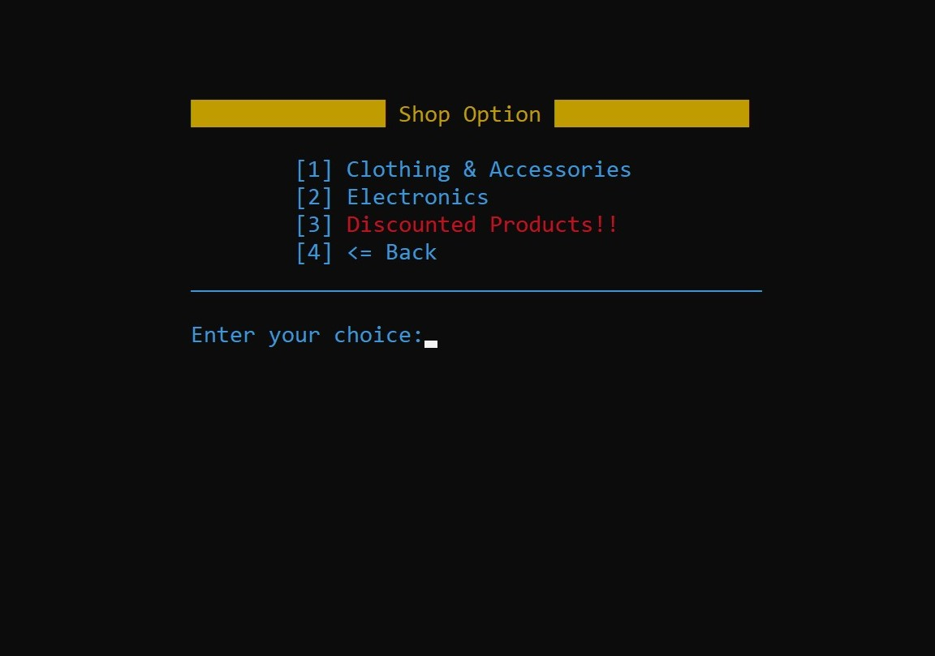
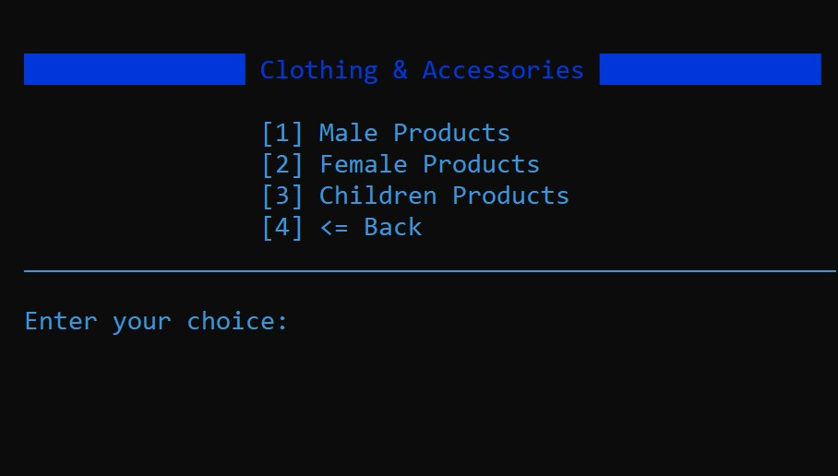
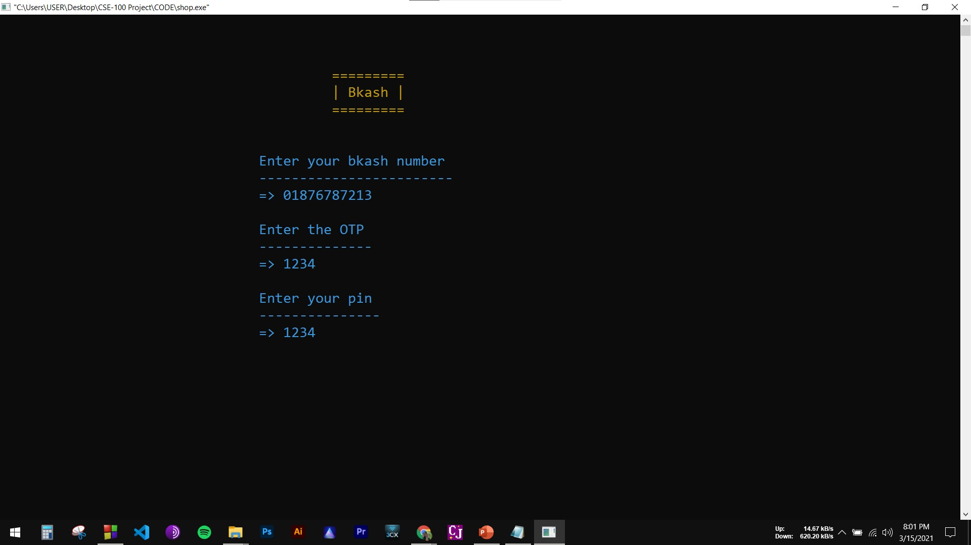
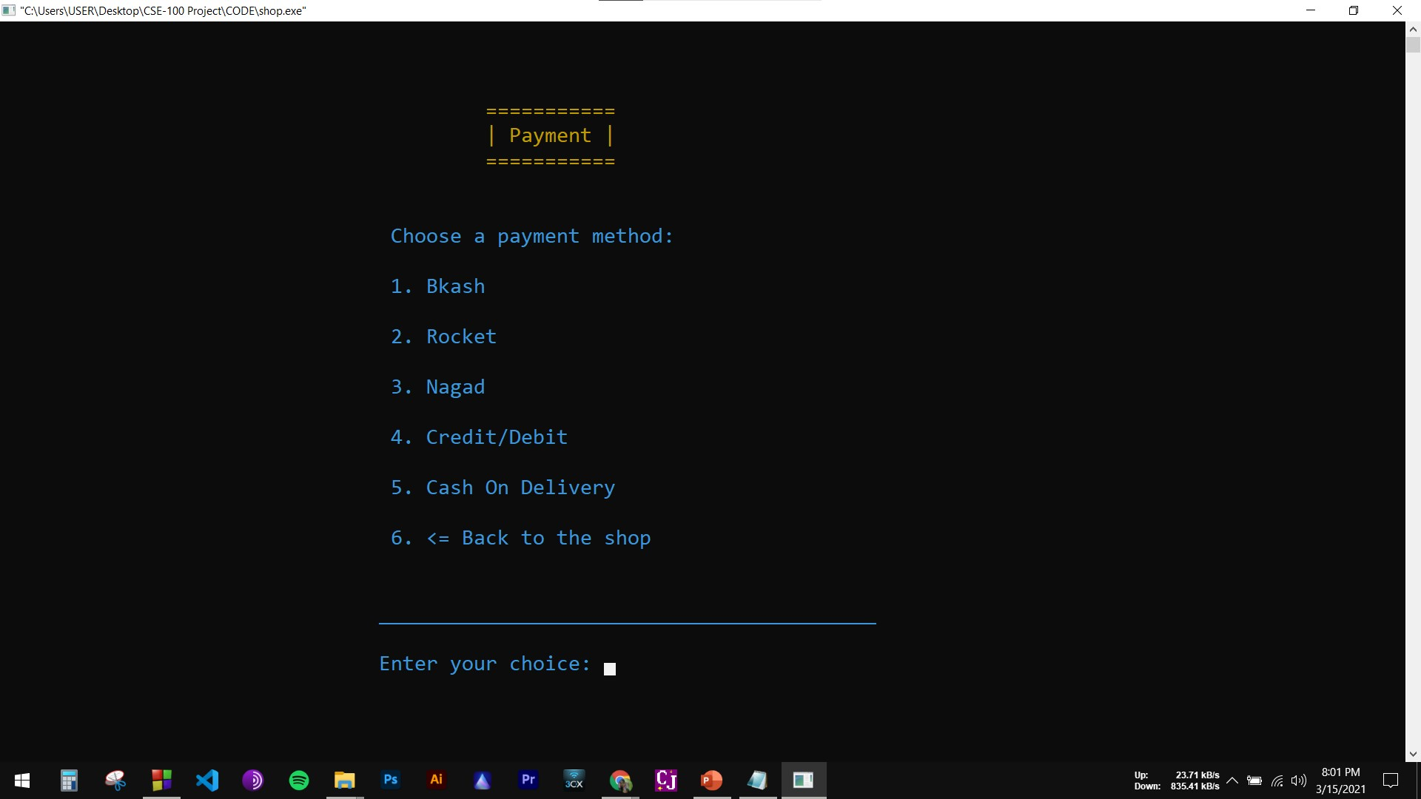
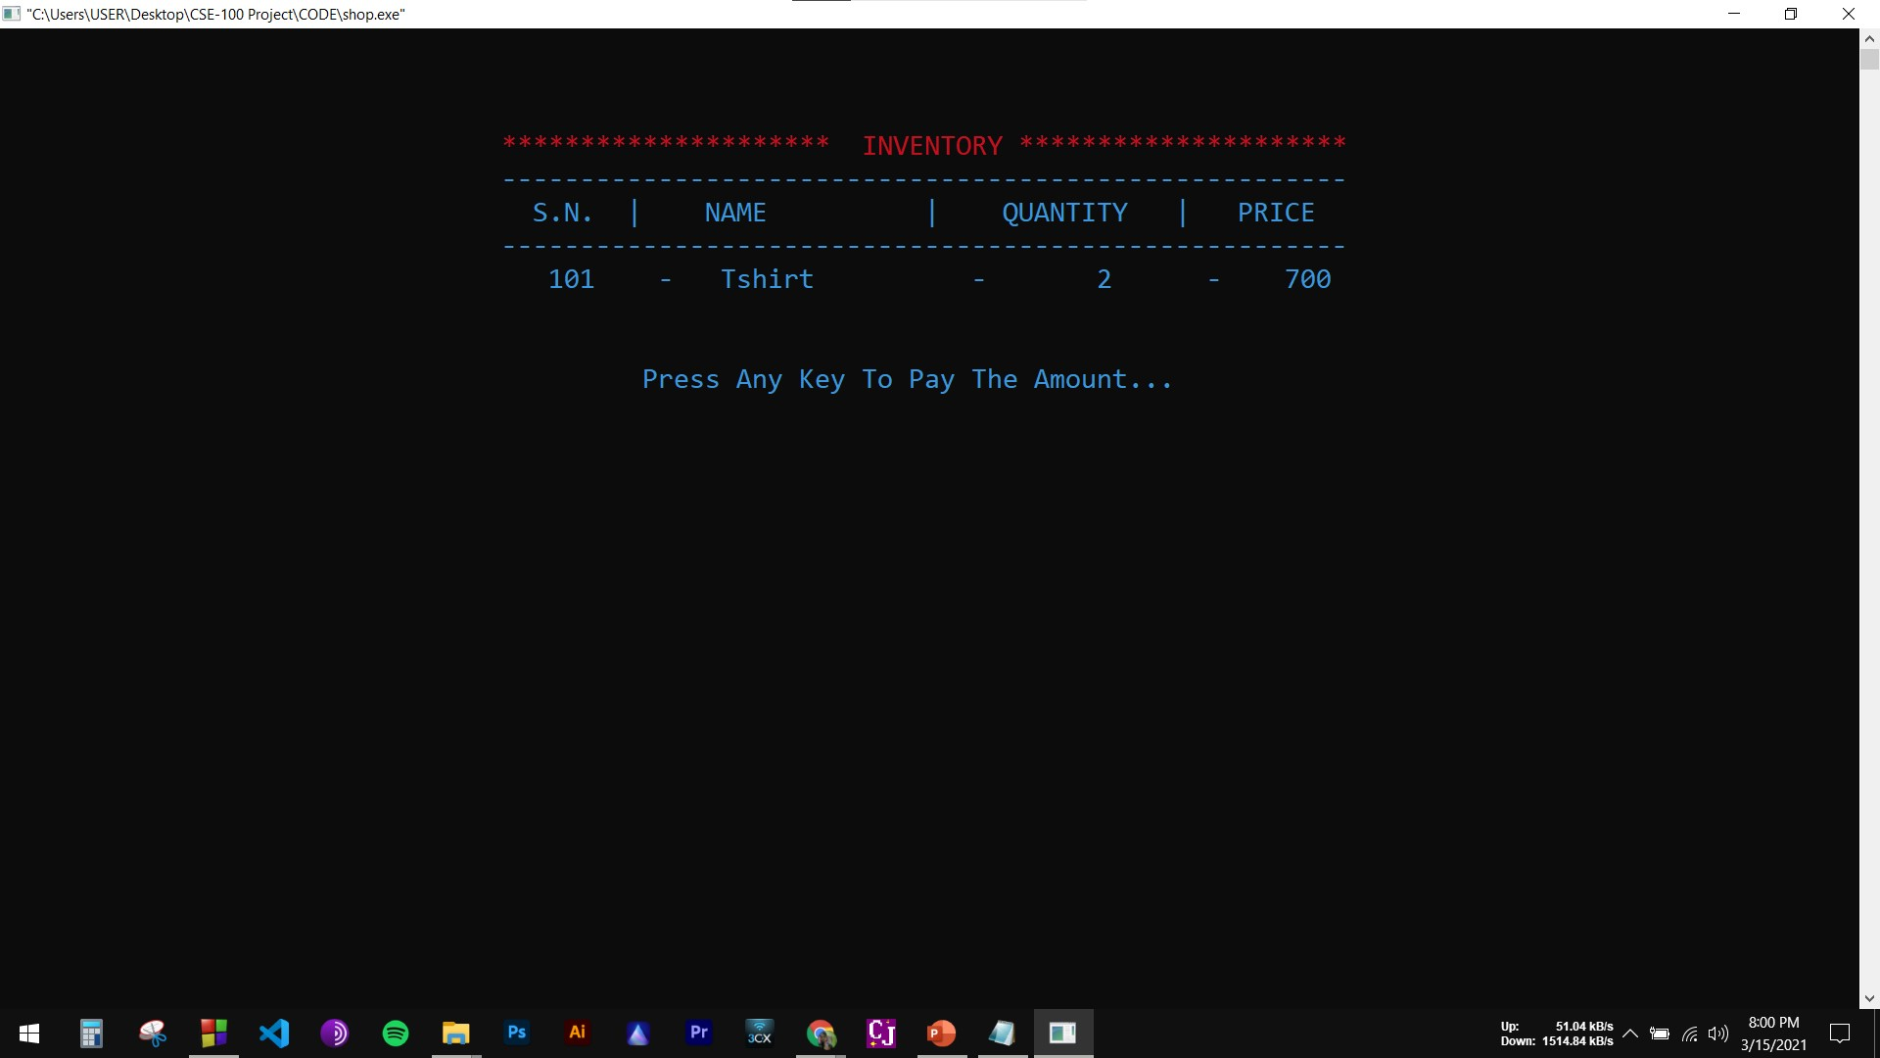
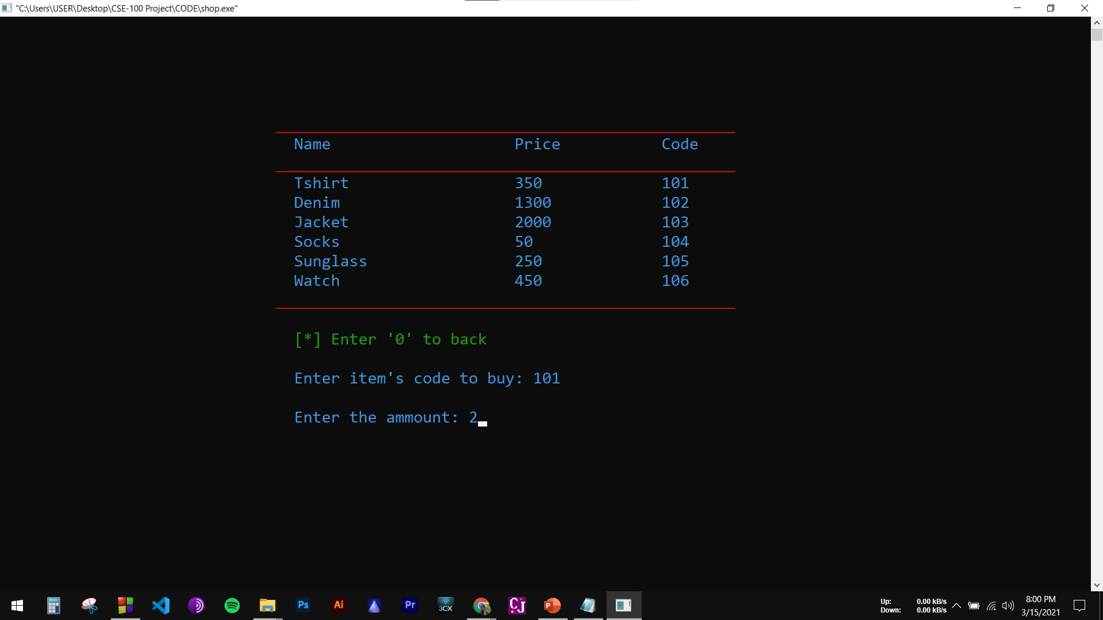
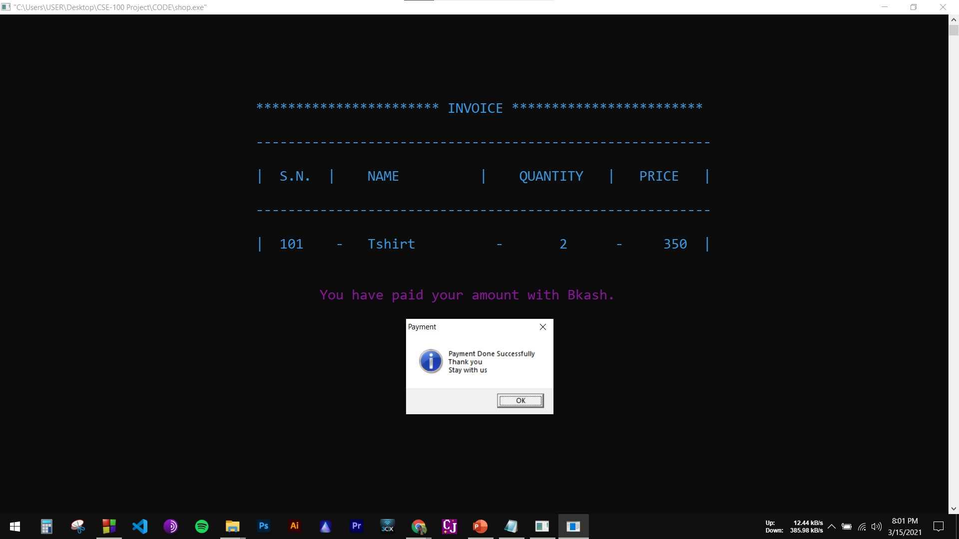
How to buy a product

Slide 13
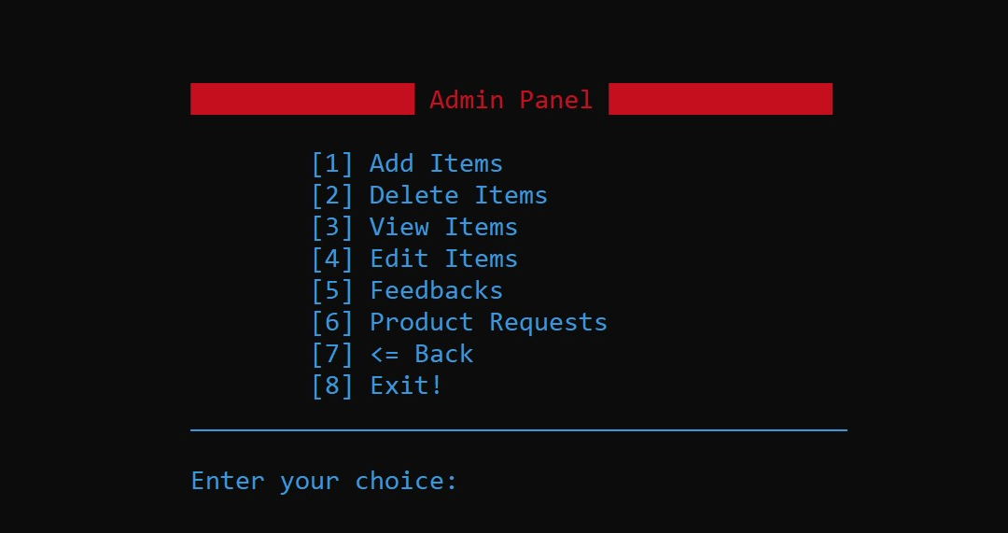
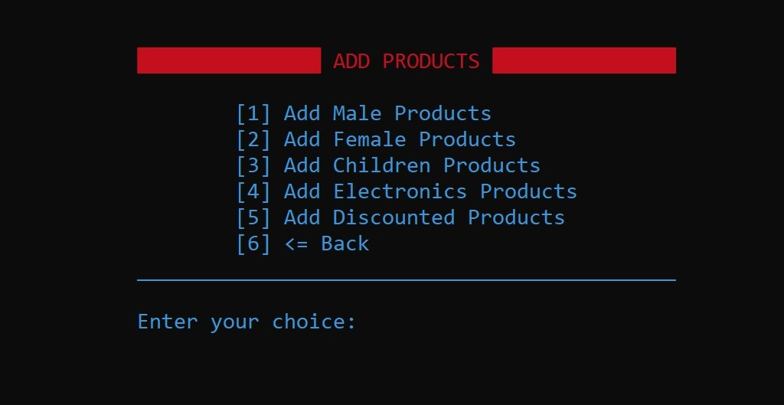
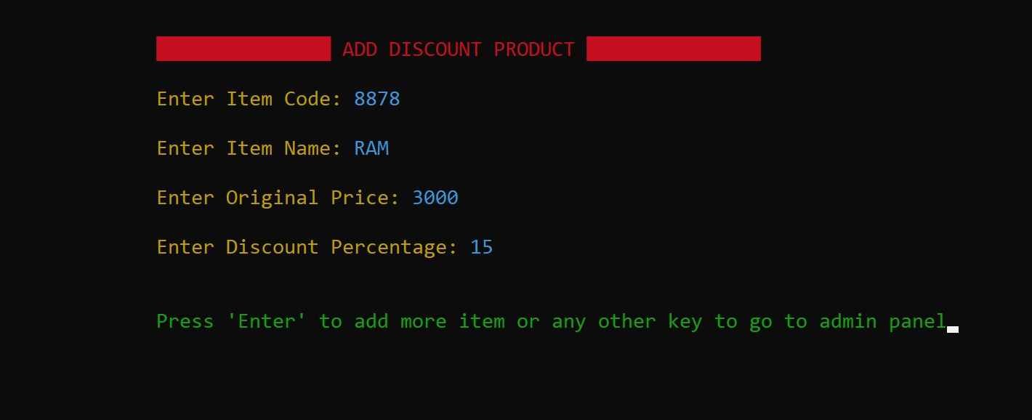
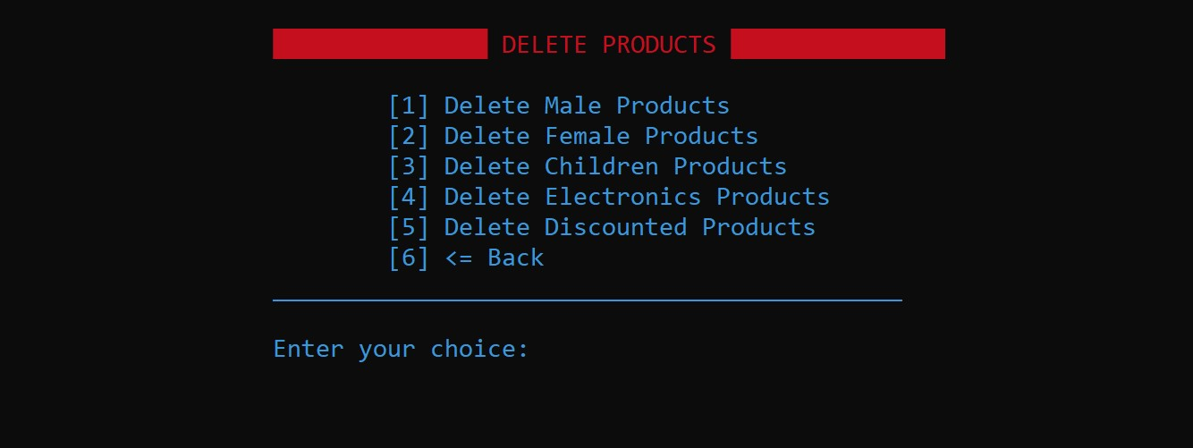

How to add item
How to delete item

Slide 14
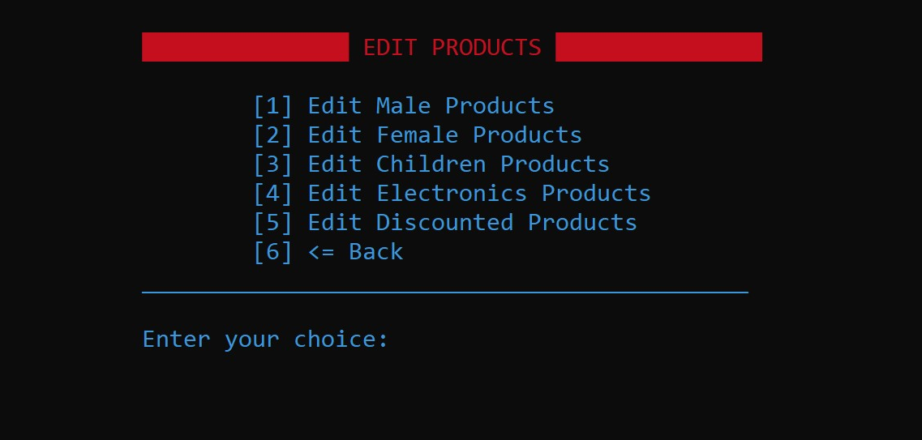
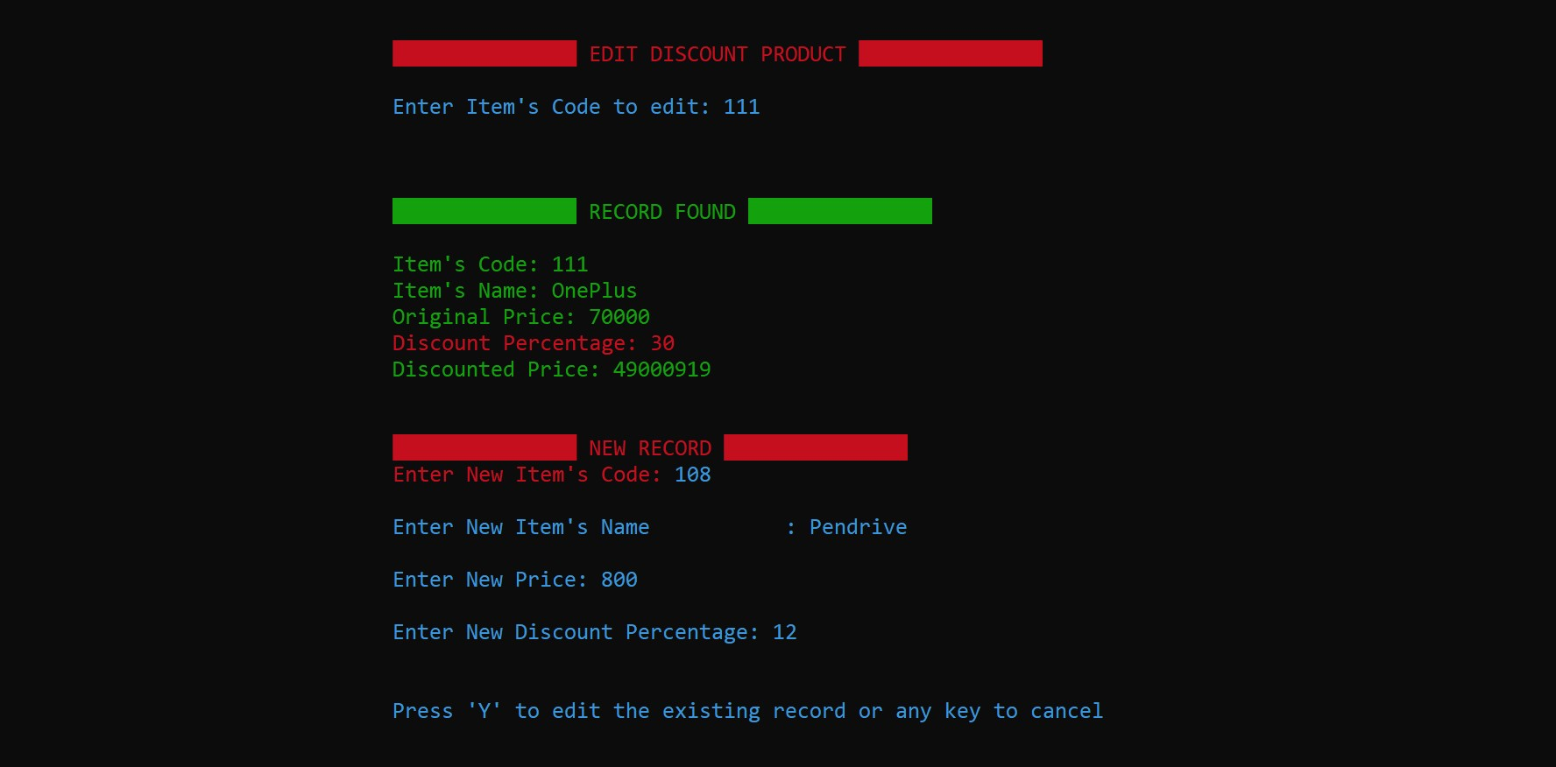
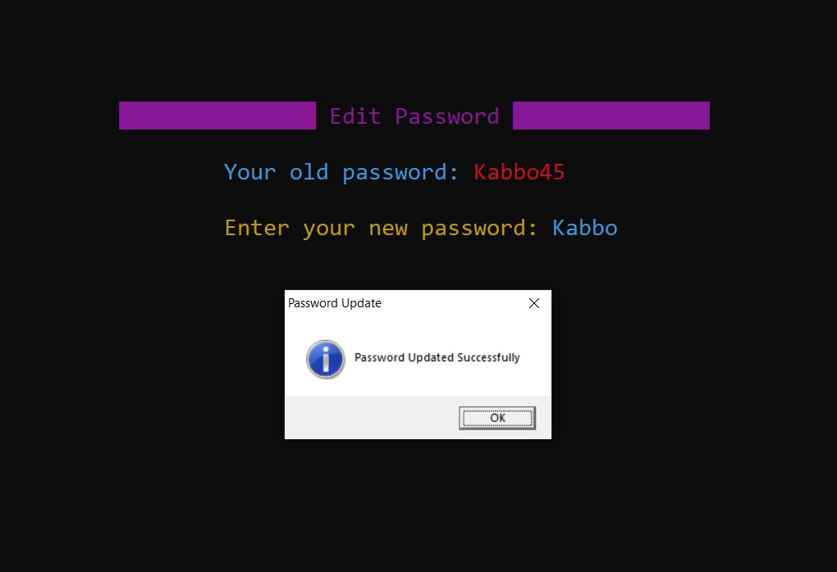
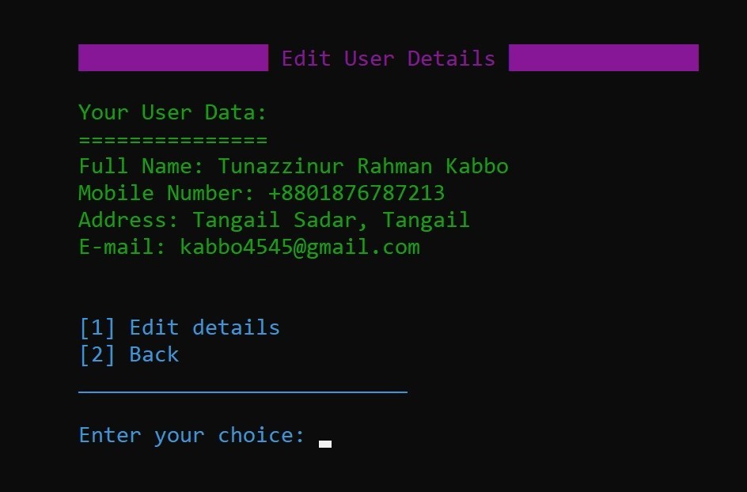
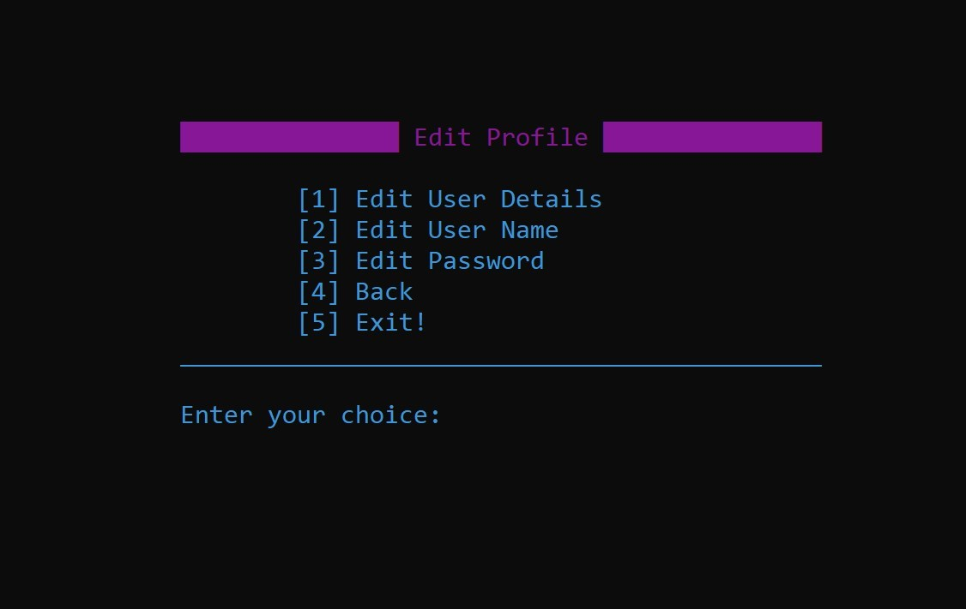
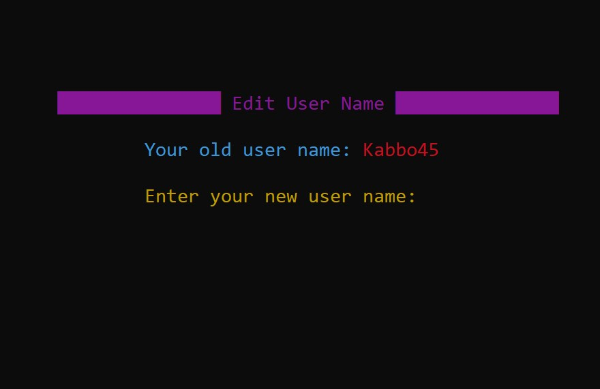
How to edit item
How to edit user details, username & password

Slide 15

Conclusion
1. All in all, online shopping is revolutionary medium for purchasing goods from home.
2. By which people will be able to alleviate their time and their sufferings.
3. Thus this shops has many options that is not available in the physical market.
4. Example: Our online multi shop is one of them.
5. them. Here we added user friendly user panel and admin panel.
6. Both buyers and sellers can use this program without any technical problems.
7. On the other hand we added the top most security system in our program.
8. So, it can be said that online shop is an important & secure medium to sell goods
from home.

Slide 16

Build a secure and fluent shopping service
Reduce difficulties for people
Building a virtual super shop
Deliver goods in a secure & fast way
Make this program more efficient and fast
Add more options than before
Future Work

Slide 17
References
www.google.com
www.microsoft.com
www.quora.com
www.geeksforgeeks.org
www.programiz.com
www.daraz.com.bd
www.evaly.com.bd
www.ajkerdeal.com.bd

Slide 18

Thank You

